Slide 1
Load Characteristics of D.C. Generator Cont’d
Shunt generator
The curve is obtained keeping
  - the field circuit resistance R_{f} constant and
  - the speed constant.
Referring to the circuit on the next slide, the
fall in terminal voltage is due to
  - I_{a}R_{a} drop and
  the reduction in field current.

Slide 2
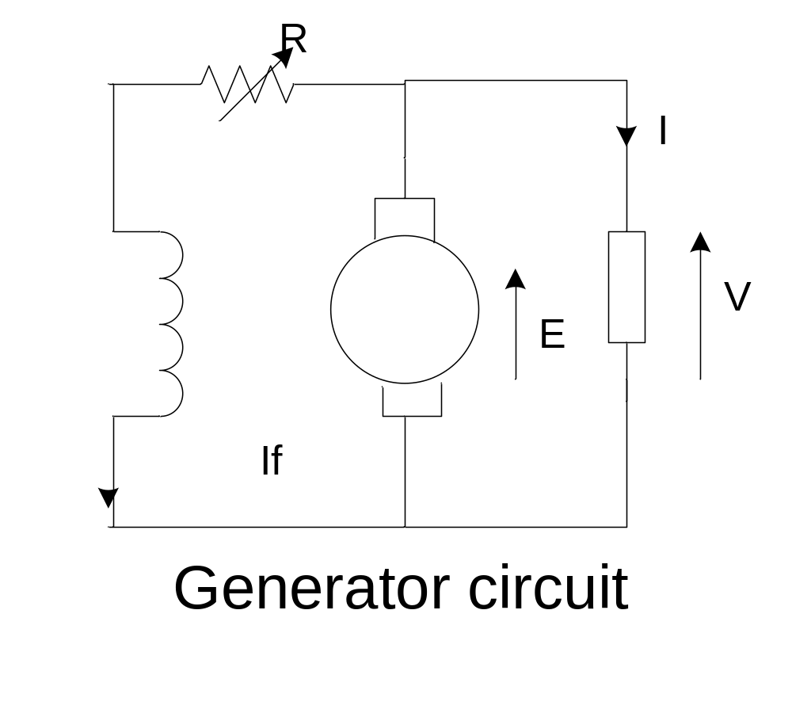
Shunt generator cont’d

Slide 3
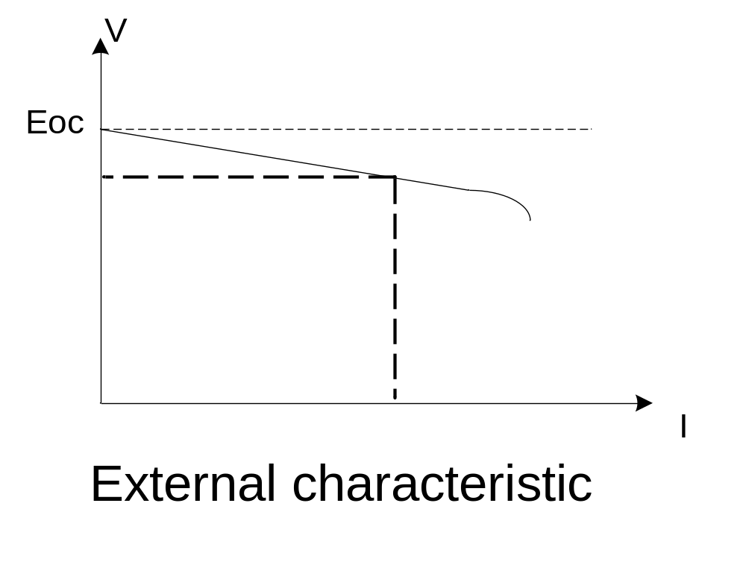
Shunt generator cont’d

Slide 4
Shunt generator cont’d
The voltage drop from no load to full load is
about 15%.
Recall that that of the separately excited generator is about 10 %
The field regulator can be used to regulate the terminal voltage V manually as the load current I changes

Slide 5
Shunt generator cont’d
The fall in the terminal voltage is more marked
than with the separately excited generator.
Why?
The voltage drop due to R_{a} results in
a decreased field current
which in turn results in
a decreased air-gap flux
and hence reduced emf, E.

Slide 6
Shunt generator cont’d
Referring to the generator repeated on the next
slide, the external characteristic can be obtained
as follows:
For any value of V, calculate the field current I_{f} = V/(R+R_{f})
From the O.C. curve, determine the corresponding E
Calculate the armature current, I_{a}=(E-V)/R_{a}
Calculate the load current I = I_{a} - I_{f}

Slide 7
Shunt generator cont’d

Slide 8
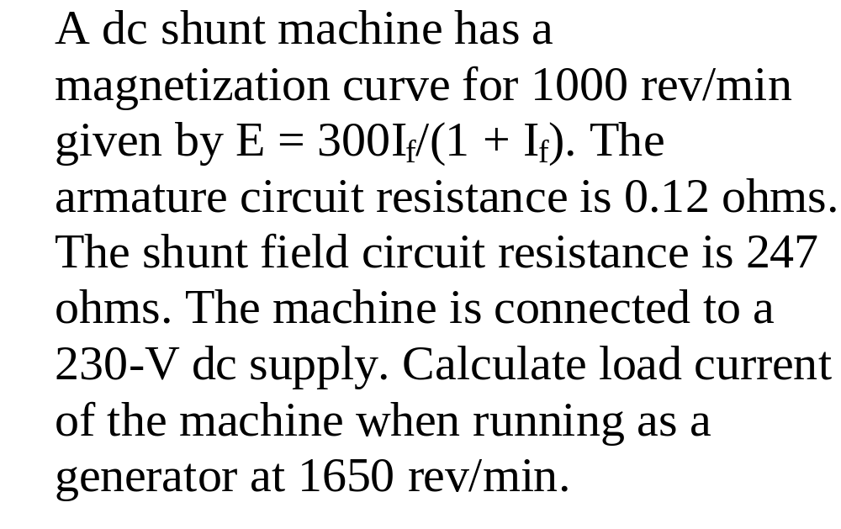

Slide 9
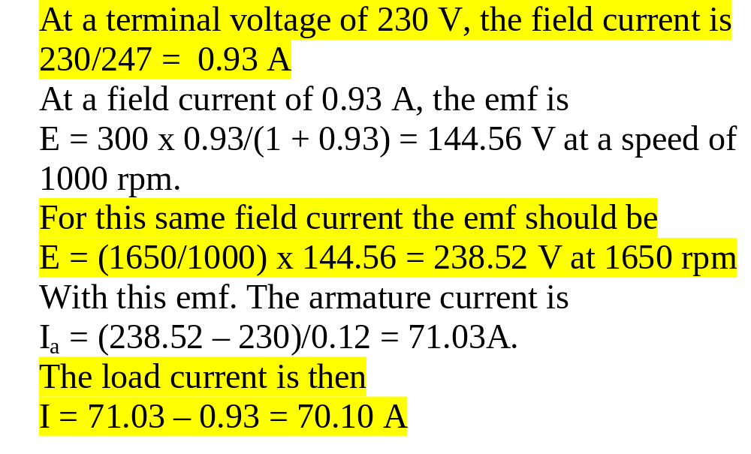

Slide 10
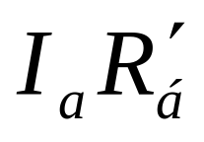
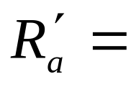
Load Characteristics of D.C. Generator cont’d
Series Generator
Referring to the circuit on the next slide, the external characteristic is readily deduced from O.C. curve by subtracting the total armature circuit resistance drop,
( total armature circuit resistance)
V(I=I_{f}=I_{a}) = E(I=I_{f}=I_{a}) – I_{a}R’_{a}

Slide 11
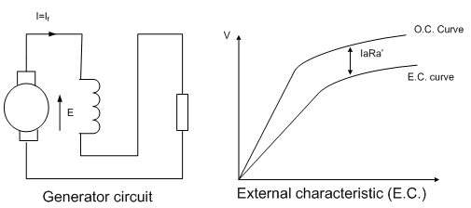
Series Generator Cont’d

Slide 12
Series Generator Cont’d
This generator is unsuitable when the voltage is to be maintained constant or approximately constant over a wide range of load current.
Series generators are rarely used as self-excited generators.

Slide 13
Load Characteristics of D.C. Generator Cont’d
Compound generator
It is a shunt generator (i.e. the shunt field predominates) with an additional field winding in series with the armature to improve its external characteristics.

Slide 14
Compound generator cont’d
The compounding is either
  cumulative (the two fields aid each other)
  or
  differential (the series field mmf opposes
  that of the shunt field).
To achieve its intended purpose,
compounding must be cumulative

Slide 15
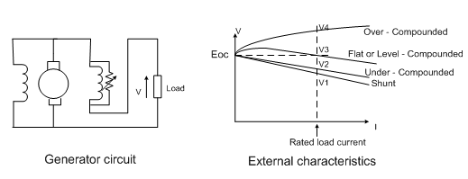
Compound generator cont’d

Slide 16
Compound generator cont’d
The level-compounded generator has its terminal voltage practically constant from no load to full load, (i.e., it compensates for I_{a}R_{a} drop).
The over compounding is used when it is necessary to compensate
  not only for the armature circuit voltage drop
  but also for the drop in the feeder line
  between the generator and the load.

Slide 17
Compound generator cont’d
The degree of compounding (over, level or under) may be adjusted by means of diverter connected across the series field.

Slide 18
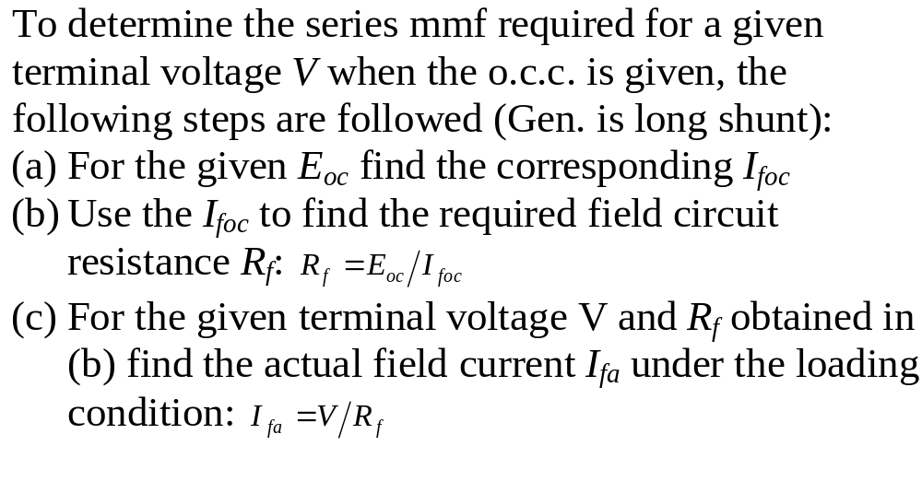
Compound generator cont’d

Slide 19
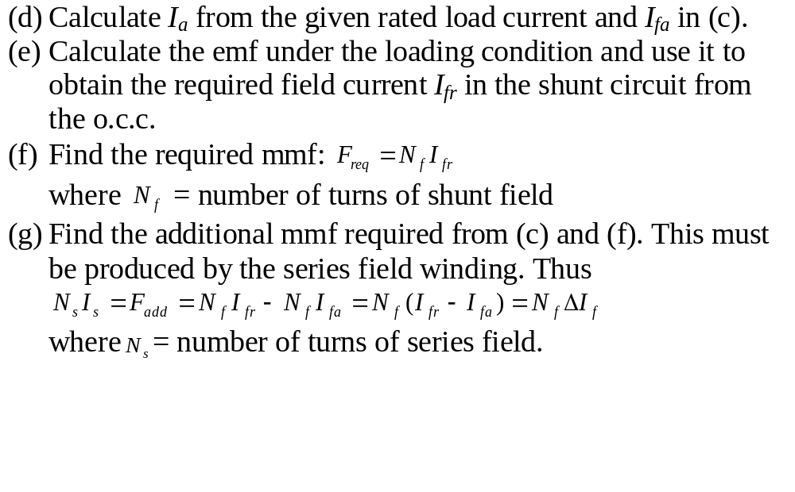
Compound generator cont’d

Slide 20
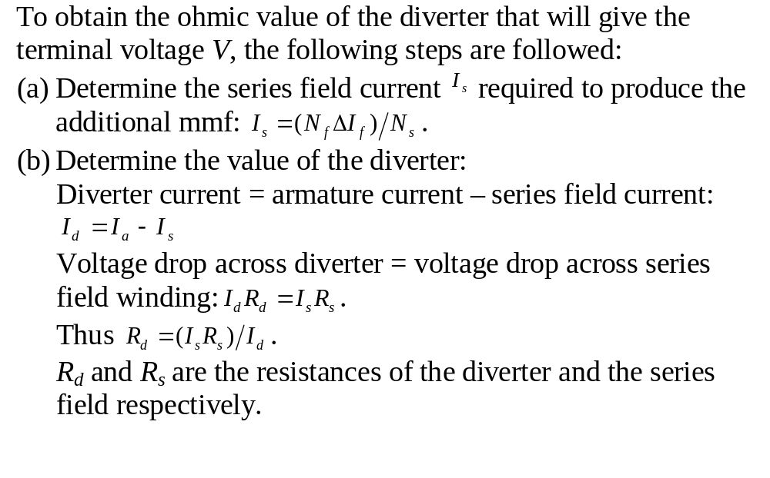
Compound generator cont’d

Slide 21
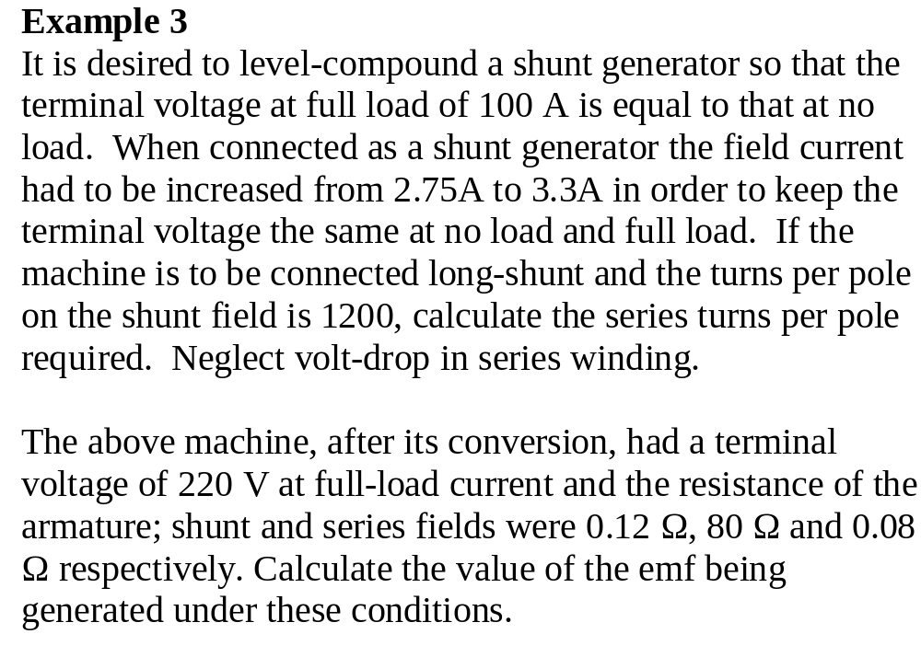

Slide 22
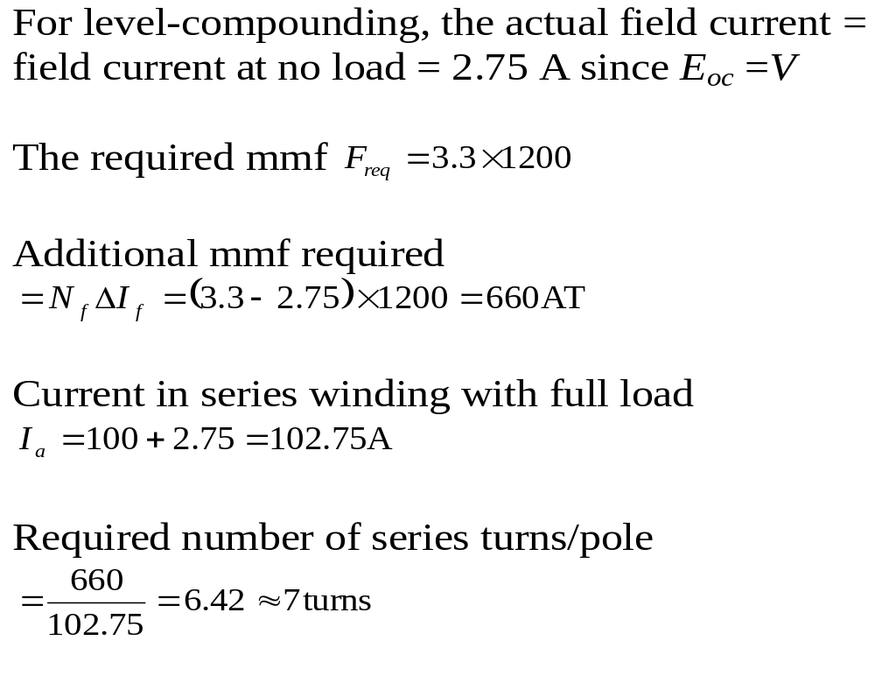

Slide 23
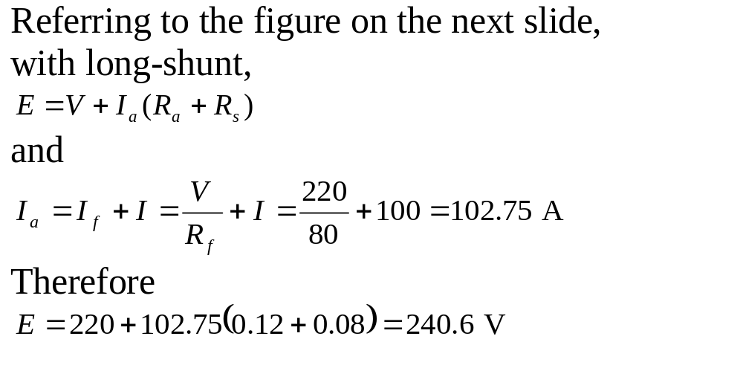

Slide 24
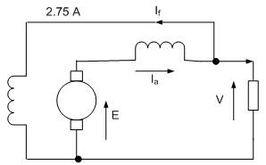

Slide 25
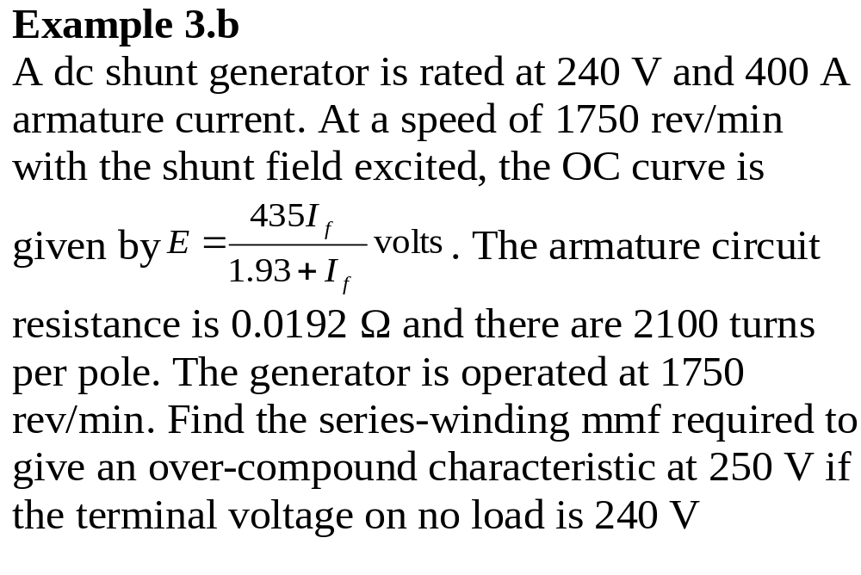

Slide 26
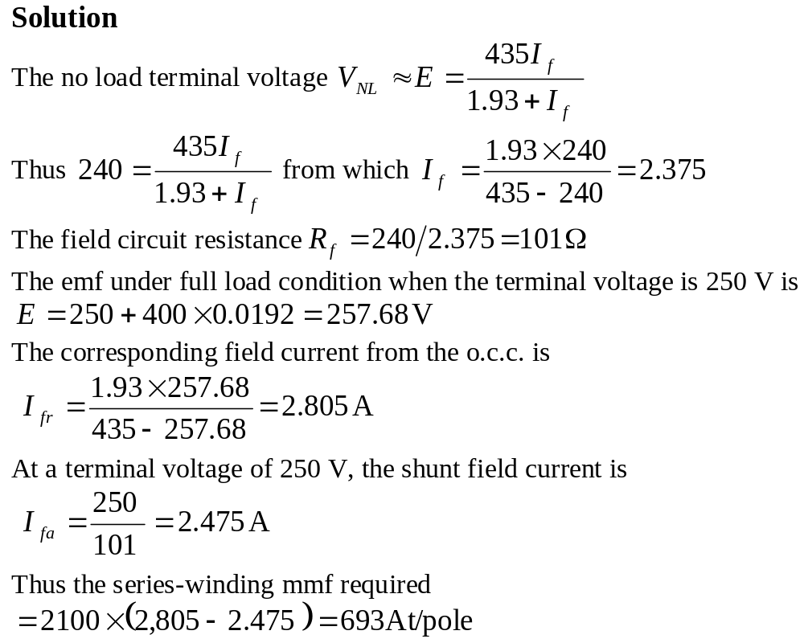

Slide 27
D.C. Motors
Introduction
The torque-speed characteristic of a motor must be adapted to the type of the load it has to drive.
To meet the various requirements of mechanical loads three basic types of motors have been produced.
They are dc shunt motor, dc series motor and dc compound motor.

Slide 28
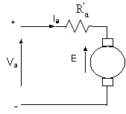
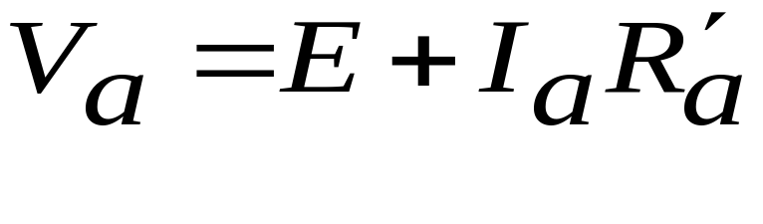
Torque of dc motor
Armature circuit of the three motors:
Armature voltage equation from KVL:

Slide 29
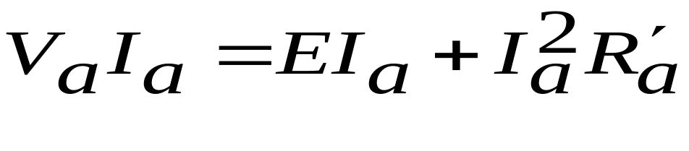
Armature power equation:
V_{a}I_{a} = total electric power supplied to the
armature
I_{a}²R’_{a} = total copper loss of the armature
circuit.
EI_{a} = the difference between the above two
quantities therefore represents the
mechanical power developed by the
armature.

Slide 30
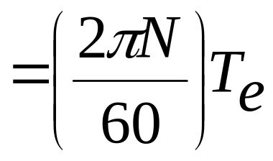
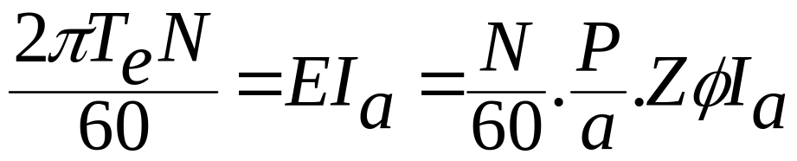
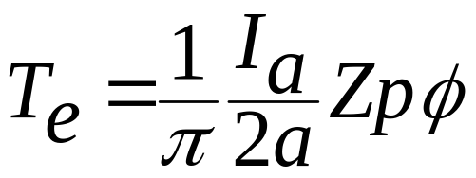
Let T_{e} = mechanical torque developed in Nm
Then power developed at a speed of N rpm
Therefore
From which
This expression holds equally for generators
and motors.

